Slide 1

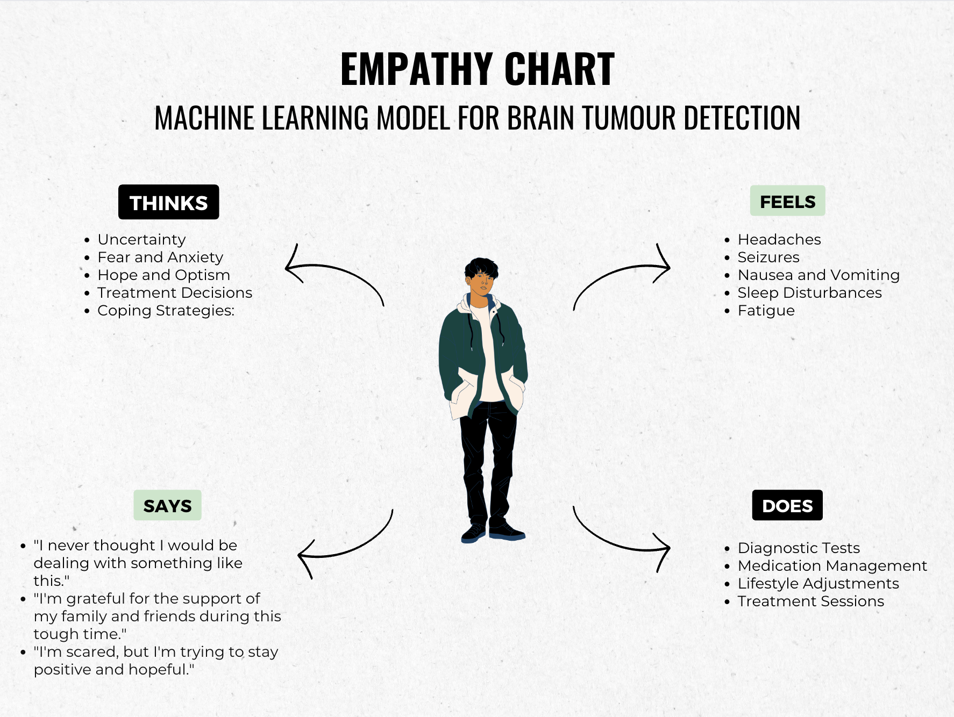
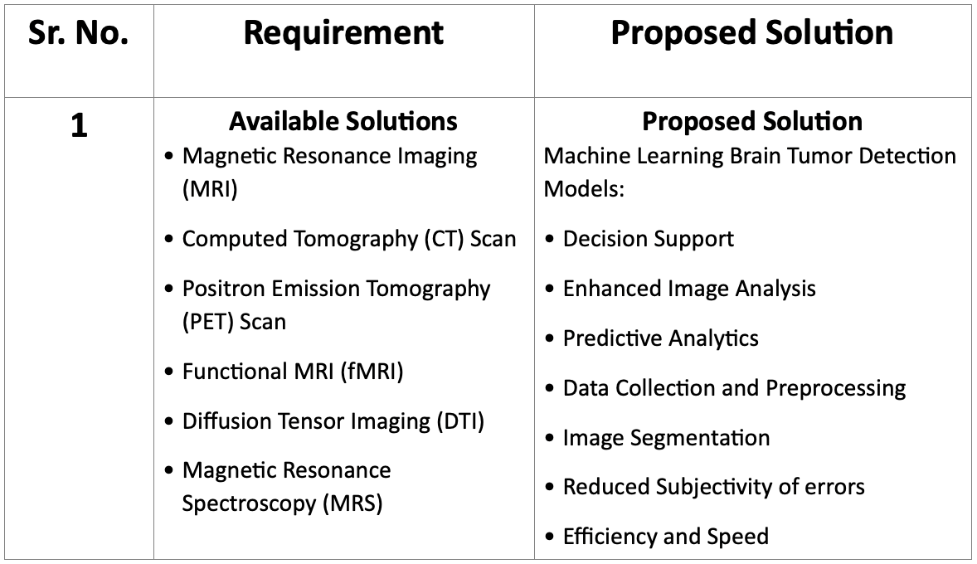
Proposed Architecture/ Diagram:
MIT SCHOOL OF COMPUTING
Class : TYCSE-8
Group Id: 5
DEPARTMENT OF COMPUTER SCIENCE & ENGINEERING
Machine Learning Model for Brain Tumour Detection
Taranjot Kar, Nikhil Dagwar, Pratik Pawar, Sumit Walke
Ideation
Proposed Block diagram
P
Faculty Guide: Prof. Anuja Chincholkar
Abstract/ Objectives:
1. It can be accessed by unlimited number of users.
2.The user can have access to all the information in the site with limited services and provide extra services to registered users.
3.Only registered members will be provided with communication between user, experts and owner of the house.
4. . Our project laid a web based platform for the city guide and can search every place in the city with out taking the help of any personal broker.
Empathy Chart
Problem Statement : Timely detection of brain tumors is critical for effective treatment, yet traditional methods relying on Radiologist's assessments can be time-consuming and are subject to human error.
Proposed Solution: Our model deals with automated brain tumor detection and classification using transfer learning i.e using a pre-trained model .Normally the anatomy of the brain is analyzed by MRI scans or CT scans, our aim is to detect and identify the tumor in brain through images generated by the Magnetic Resonance Imaging. The main reason for detection of brain tumors is to provide aid to clinical diagnosis and to provide an algorithm that guarantees the presence of a tumor by combining several procedures to provide a foolproof method for the detection of tumors.
Scope and Feasibility: The system can be used by neurosurgeons and healthcare specialists. The system incorporates image processing, pattern analysis, and computer vision techniques and is expected to improve the sensitivity, specificity, and efficiency of brain tumor screening.

